Slide 1
Sqw: a ’liquid’ TOF
Aim: A simple spectrometer (and diffractometer)
Create a new instrument from 'template (test)'.
Call it Liquid_simple and define input parameters (lambda=2.36, string coh=”Rb_liq_coh.sqw”, string inc=”Rb_liq_inc.sqw”)
Insert a Source_simple φ1cm sending λ=lambda with dλ/λ=1%. Focus onto a 1x1cm² area.
Insert an Isotropic_Sqw 3m away, using σ_{coh}=coh, σ_{inc}=inc with φ1cm x 5cm.

Slide 2
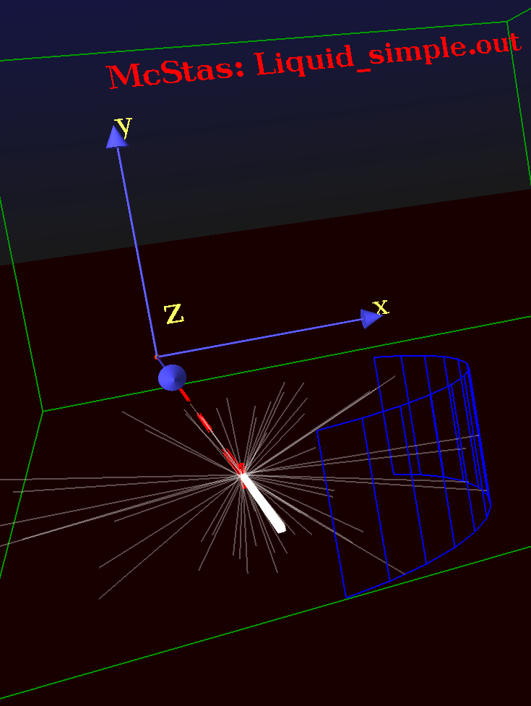
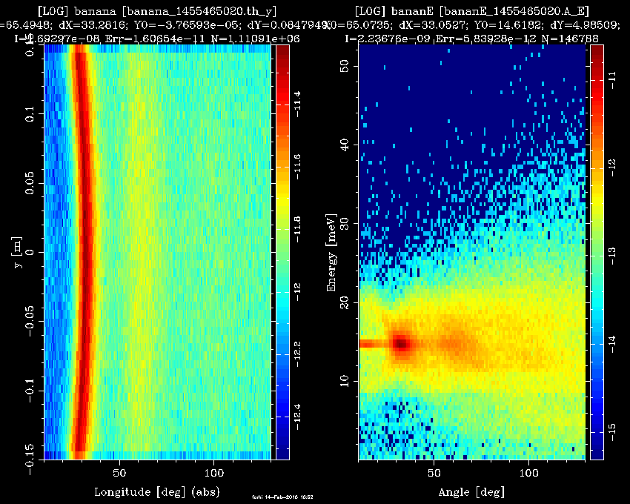
Sqw: a ’liquid’ TOF
Add a Monitor_nD cylindrical detector φ1m x 30cm, sensitive to (θ,y) for diffraction, centred on the sample, with 100 bins.
Add the same, but sensitive to (angle,energy) with automatic energy limits.
Save, run in Trace 3D to check geometry.
Run in Simulation/PGPLOT mode with 1e8 neutron events.
Plot results !
Comment on the diffraction pattern and the inelastic one.

Slide 3
Sqw: a ’liquid’ TOF: contributions
Insert an instrument variable in the DECLARE block, as 'flag_scat'.
DECLARE %{
int flag_scat=0;
%}
After the AT token of the 'sample', insert an EXTEND block that sets flag_scat to the number of SCATTERED events.
EXTEND %{
flag_scat=SCATTERED; // nb of scattered events
%}

